Slide 1
MEC 402 Casting, Welding and Forming
Dr. Arjyajyoti Goswami
arjyajyoti.Goswami@me.nitdgp.ac.in
+91-9953167384

Slide 2
Gas Metal Arc Welding:
What is Gas Metal Arc Welding
Set up for GMAW
Electrode tip nomenclature
MOBILE CATHODE SPOT
Shielding gases in GMAW
He vs Argon

Slide 3
Why study about it
To understand the different salient features of GMAW, most notably, the set-up, electrode tip arrangement, Mobile cathode spot, effect of shielding gases on the bead profile.

Slide 4
SMAW has one major limitation.
The wire electrode needs to be changed after 20-30cm of welding.
It takes up time to change the electrode.
After that the arc has to be re struck and then only the process can be continued further.
In cases where long welding needs to be done, like welding of large sheets, tanks, etc. (mostly industrial applications) SMAW is unsuitable for these reasons.
An alternative was needed.

Slide 5
Gas Metal Arc Welding (GMAW) or Metal Inert Gas Welding (MIG)
GMAW or MIG is a type of Arc Welding process in which fusion is achieved between 2 metallic workpieces utilizing the heat obtained from an arc struck between the workpiece and a continuously fed consumable wire electrode. The arc is continuously shielded by a protective covering of inert gas.
Arc is between metals – hence Metal
Shielded by inert gas – hence Inert
Together - Metal Inert Gas Welding or MIG.
GMAW uses a wire electrode, mostly in semi-automatic mode of operation.

Slide 6
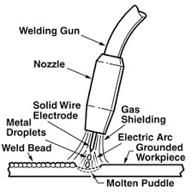

Slide 7
An important distinction (for knowledge and probable show off !!)
What we are reading is MIG – Metal Inert Gas Welding.
Most times, labs or workshops uses Carbon dioxide as a shielding gas. CO2 is not exactly inert. So it will be incorrect to call it as MIG.
Rather it is called as MAG – Metal ‘Active’ Gas Welding.
Whenever the shielding gas is CO2, everything is same just the name is MAG.
Note : It is not good to show off !

Slide 8
GMAW set up

Slide 9
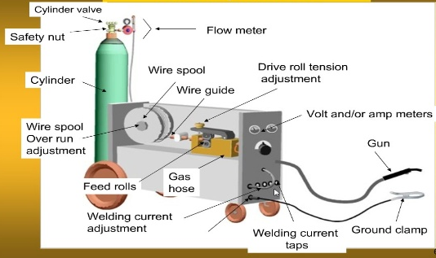
https://waybuilder.net/free-ed/SkilledTrades/Welding/10GMAW/10GMAW.asp
GMAW

Slide 10
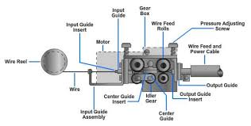
The upper gears are switched on when the trigger is pressed, the lower gears are just for support
https://waybuilder.net/free-ed/SkilledTrades/Welding/10GMAW/10GMAW.asp
Wire Feed Mechanism

Slide 11
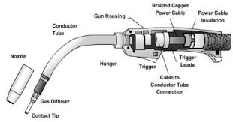
https://waybuilder.net/free-ed/SkilledTrades/Welding/10GMAW/10GMAW.asp
When the trigger is pressed the gears (upper gears) in the gear box starts rotating and the wire is fed out from the nozzle (the rate of feeding of the wire depends upon the current)
Welding Gun

Slide 12
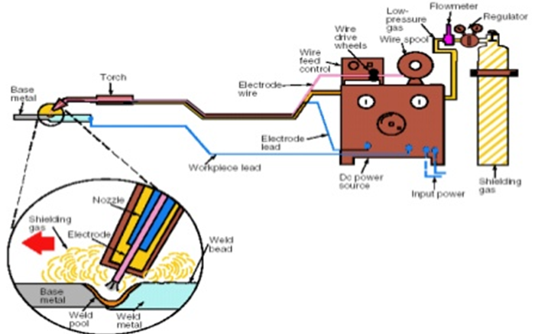

Slide 13
Electrode Tip Nomenclature

Slide 14
Nozzle
Contact Tip
Electrode
Electrode stick out
Contact to work distance
Nozzle to work distance
Workpiece

Slide 15
Mobile Cathode Spot

Slide 16
+
+
-
-
Cathode spot is the point which is closest to the opposite terminal and the stream of electrons for arc formation are released from this point

Slide 17
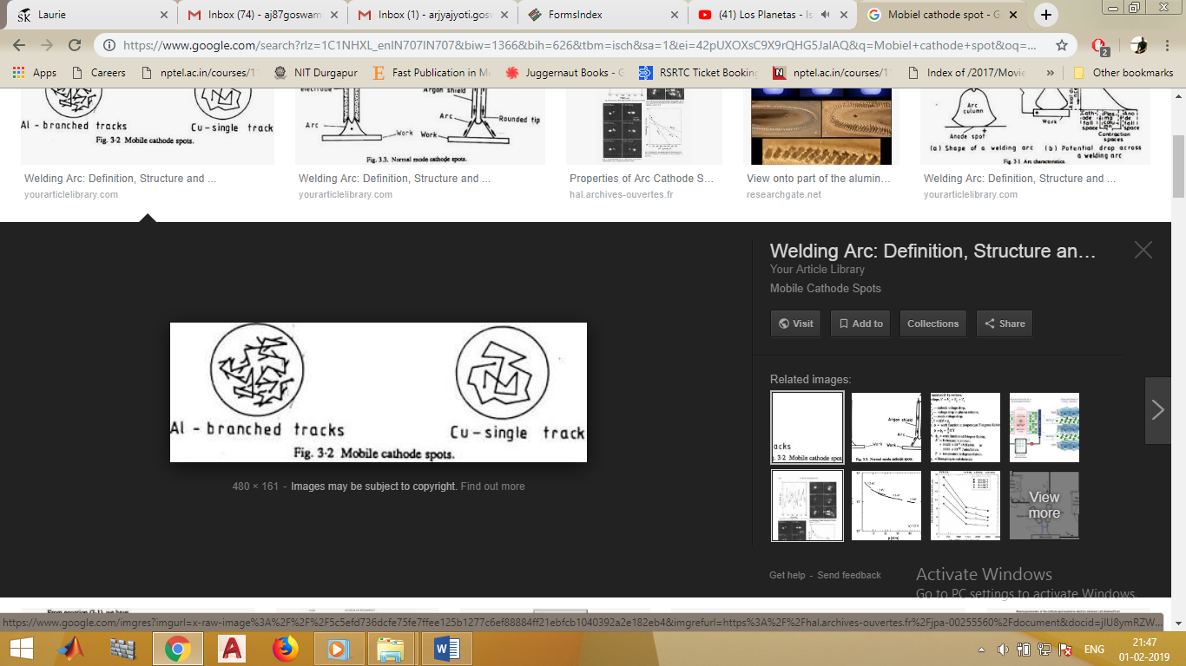

Slide 18
Shielding gases in GMAW

Slide 19
Criteria
Helium
Argon
Brightness
Brighter
Less Bright
Thermal Conductivity
Higher
Lesser
Molecular Weight
Lesser
Higher
Bead Width
Higher
Lesser
Bead Penetration
Lesser
Higher
Preferred welding position
Overhead since He is lighter than air
Flat or Horizontal
Bead width and Bead penetration are being compared when all the other process parameters like Current, Voltage, Shielding gas flow rate, weld travel speed etc. are same.

Slide 20
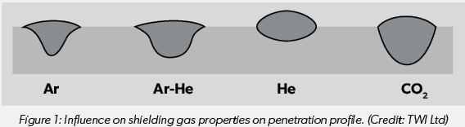
https://www.assda.asn.au/blog/311-shielding-gases-for-welding-and-their-effects-on-stainless-steel-properties

Slide 21
Nitrogen
Mixed with Ar provides more energy than Ar alone. This is beneficial when welding material of high conductivity as Cu, because it tends to conduct away the heat before it can even melt the work piece. Using Nitrogen as shielding gas concentrates the heat at a particular point which helps in countering the effect of very high thermal conductivity of Cu, which dissipates away the heat.
Frequently used with Duplex Stainless Steel, which can lose some of its Nitrogen during welding. The shielding gas helps to make up for it.

Slide 22
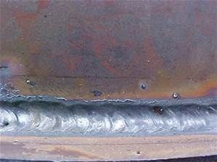
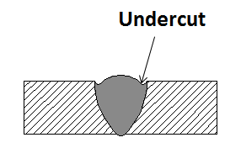
Oxygen
Small amounts of oxygen in the shielding gas reduces the surface tension between the molten weld pool and the surrounding atmosphere and results in a flatter and smoother weld bead with less tendency to undercut the parent metal.
https://welderportal.com/7-most-common-welding-defects/
https://za.pinterest.com/pin/545357836107032442/

